Slide 1
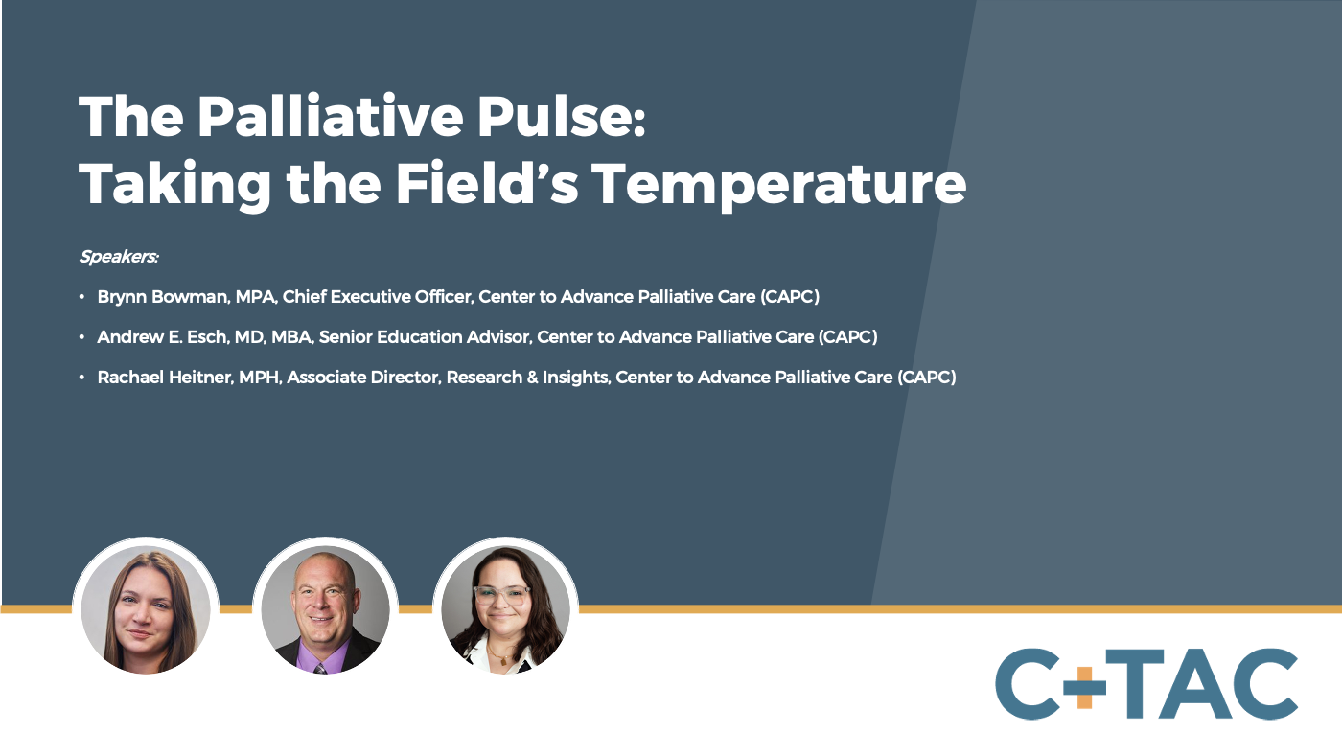

Slide 2
Voices from the Field – Findings from CAPC’s First Annual Palliative Pulse Survey
Brynn Bowman, MPA
Andy Esch, MD, MBA
Rachael Heitner, MPH, MA
October 22, 2024

Slide 3
In Their Own Words…
The slow pace of educating the public that we exist.
How do we support our various interdisciplinary team members without any one person or group feeling marginalized or less important?
Team members are becoming isolated from each other just to accommodate the increasing patient load.
Hospital staff introduce me as “pre-hospice.”
Programs and individuals have been cut based on basic programmatic cost/revenue assessments that fail to account for palliative care's overall value to the organization.
Who will take over when I am gone?

Slide 4
In Their Own Words…
Being a part of our team, which is collaborative in our approach with patients, and where all voices are equal.
Watching any learner have a “lightbulb” moment when they see a conversation go well.
Helping reduce human suffering is extremely rewarding because it helps me feel like I am making my part of the world a better place, even in small ways.
I really do love the people I work with.

Slide 5

What is the Palliative Pulse Survey?
CAPC’s new, annual survey of the palliative care field
How are you doing?
What are you concerned about?
What can we do to help?

Slide 6
Why the Palliative Pulse Survey?
To know where we’re needed – we need to know what they’re experiencing
The Palliative Pulse is an effort to hear from as many people in the field as possible, in close to real time.

Slide 7

Palliative Pulse Methodology
Questions were:
Adapted from prior CAPC COVID-19 surveys
Tested with interdisciplinary professionals across geographies
The survey:
Was open 3/18/24 – 5/6/24
Contained 29 questions, the majority multiple-choice
Any member of a specialty palliative care team could participate
All data is based on self-report

Slide 8
Participant Demographics
Total Respondents: 759
4% of respondents were from pediatric-only programs

Slide 9
Participant Demographics
Total Respondents: 759

Slide 10
What did we find?

Slide 11
Top Three Concerns for the Next Year
Team Leaders: Ability to Meet Demand (36%), Support from Organizational Leadership (36%), Access to Qualified Hires (34%)
Team Members: Team Morale and Well-Being (44%), Ability to Meet Current Demand (38%), Support from Organizational Leadership (33%)
There was no regional variation
Total Respondents

Slide 12
Top Three Concerns for the Next Year
Programs led by Hospices/HHA: Billing and Coding (39%), Team Productivity (38%), Sustainable Payment Models (34%)
Pediatric Programs: Expanding to New Patient Populations (43%), Access to Qualified Hires (39%), Team Morale and Well-Being (39%)
Total Respondents

Slide 13
Consult Request Volumes
Overall, almost three-quarters of respondents reported higher consult volumes compared to the previous year
43% reported “much higher” volumes
Age Groups:
Adult Only (71%)
Pediatric Only (64%)
Both (80%)
There was little variation by administering organization or US Region

Slide 14
Staffing Levels
Overall, about one-third of team leaders reported an increase and one-quarter reported a decrease in their staffing levels
Variation in staffing decreases by administering organization:
Hospital: 20%
Hospice/HHA: 27%
Health System: 34%
There was slight regional variation in staffing decreases:
25% in the Midwest vs. 36% in the West

Slide 15
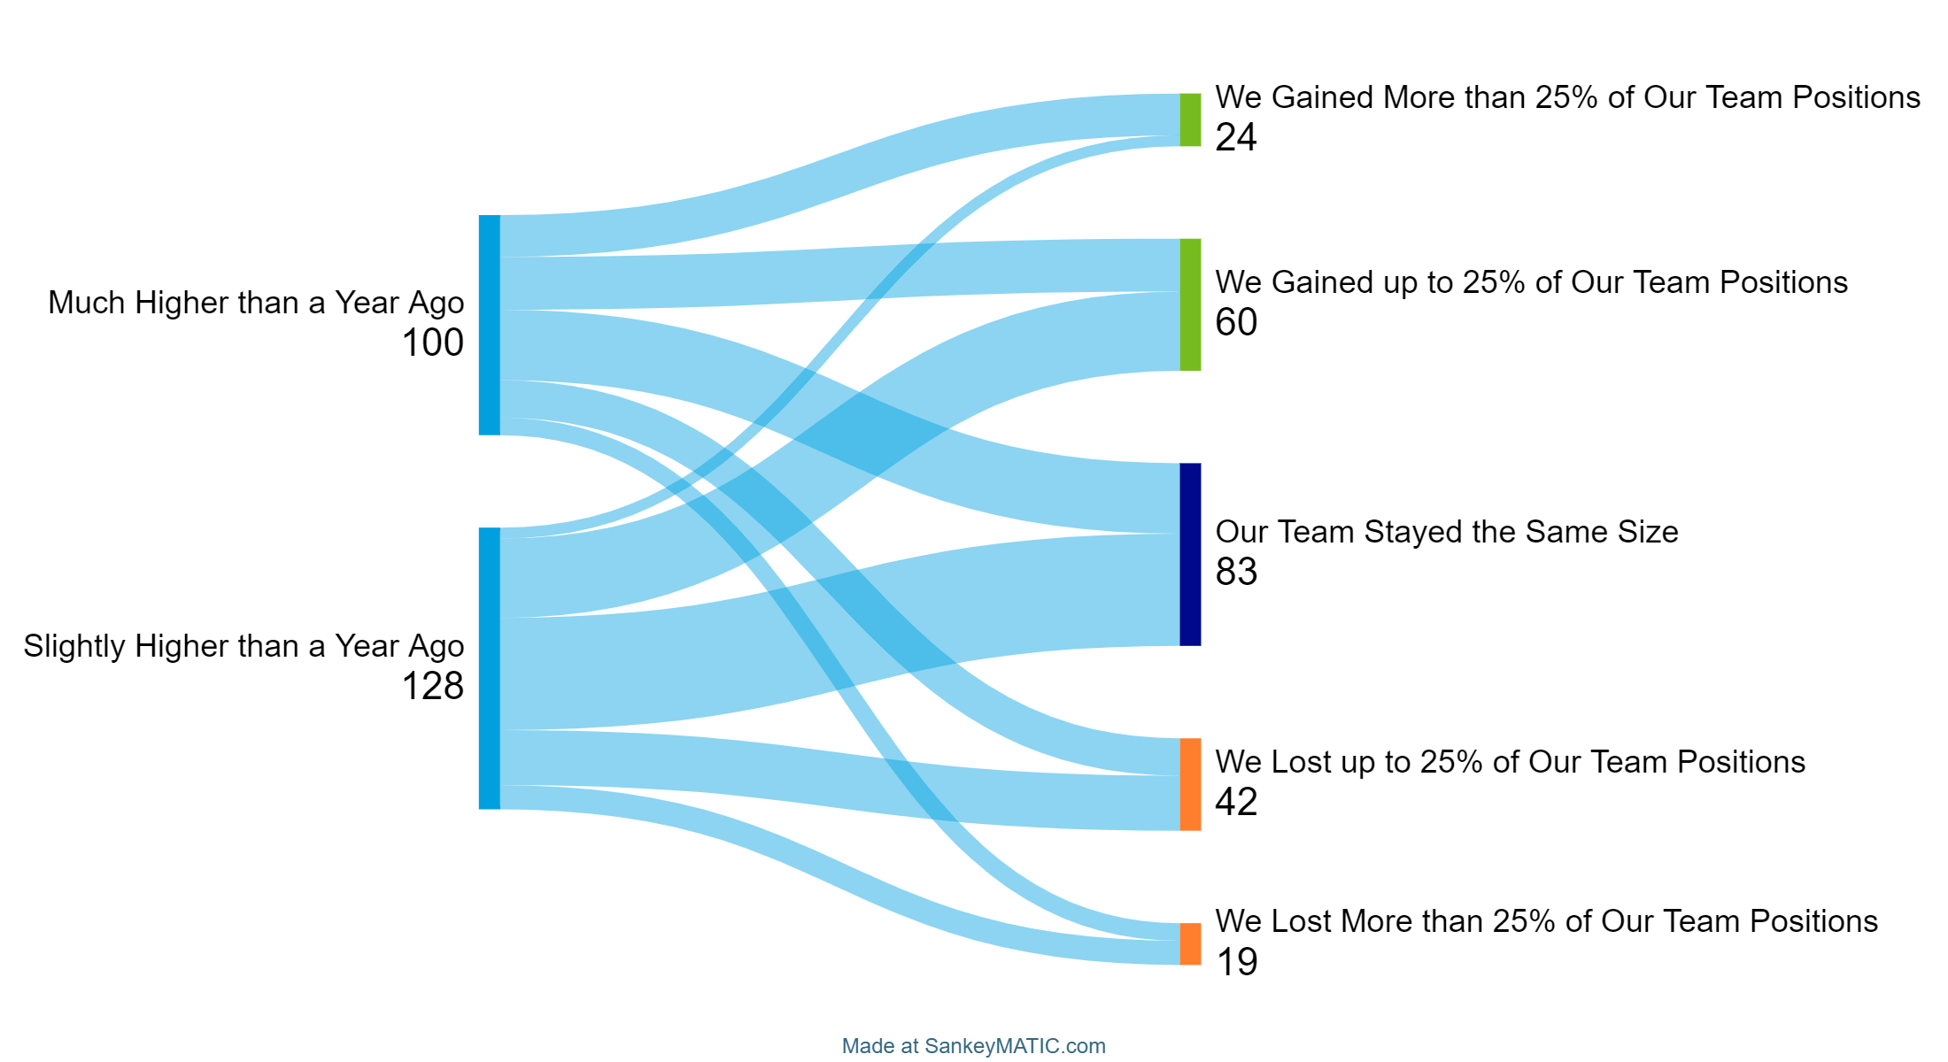
Consult Volume vs. Staffing Levels
Of the team leaders who reported an increase in consult volumes:
36% of their teams stayed the same size
27% of their teams lost staffing
→ Palliative care professionals are doing more with less

Slide 16
Team Well-Being
Almost all team leaders (97%) were concerned about their team’s well-being to some extent
Team leaders for programs operated by hospices/home health agencies and independent palliative organizations were slightly less concerned (94% and 91%, respectively)
Leaders of pediatric programs were slightly less concerned (92%) than those of adult or mixed age programs
100% of respondents from the West Coast were concerned compared to 95% in the Northeast

Slide 17
Individual Well-Being
45% of all respondents reported their well-being as “Excellent” or “Very Good”
37% for team leaders vs. 50% for team members
Slight geographic variation – this percentage was highest in the Northeast (48%) and lowest in the Midwest (40%)
There was little variation by patient age group or administering organization

Slide 18
Program Sustainability
Almost all (92%) team leaders were worried to some extent about the continued viability of their palliative care programs
Concern was slightly lower in pediatric programs (92%) than in adult-only programs (97%) or those that treat all ages (99%)
There was some regional variation: the Northeast had the highest concern (96%) and the South had the lowest (89%)
There was little variation by administering organization

Slide 19
In Their Own Words…
Upper management only looks at numbers and makes decisions with no regard to how patient care will be affected.
As always we don't have the staffing we would like to be able to see as many patients as fast as we would like.
I'm not doing enough to keep the team's morale up and this may result in people leaving their positions. The high clinical demand makes the thought of losing team members nerve-racking.

Slide 20
Understanding What Palliative Care Is – And Isn’t
Sub-Group | Example Quotation
Organizational Leadership | I do not believe that administration understands what palliative care is.
Potential Referring Providers | Having to justify the need for palliative care to colleagues, convincing staff that palliative care isn't just end of life care and doesn't go around killing patients, hearing that "the family isn't ready" or "they're not dying right now."
The Public | The lack of resources to fund our work and the challenges that come with the general public's misunderstanding of hospice versus palliative care.

Slide 21
Health Equity Work
Category | Count | Category | Count
People in Rural Areas | 39 | Veterans | 22
Black or African American | 30 | People who Identify as LGBTQ+ | 18
People without Health Insurance | 27 | People who are Incarcerated | 12
People with Unstable Housing | 25 | People who are Undocumented | 12
Hispanic or Latino | 23 | American Indian or Alaska Native | 11
People with Developmental Disabilities | 23 | Asian American or Pacific Islander | 11
38% of team leaders said they were involved in general work to improve health equity
33% of team leaders said they were not currently involved in health equity work

Slide 22
Future CAPC Content
Notes:
As you can see, everyone has different needs…
Team Leaders’ top interests: Operating a community program and program measurement/metrics
Team Members’ top interests: Clinical training and “Emotional PPE”/mental health
Pediatric programs: Leadership Skills and Dynamics of High-Functioning Teams

Slide 23
Where do we go from here?

Slide 24
How Far We Have Come…
Top Topics Seminar 2015
Targeting and Identifying Patients
Discussing Prognosis
Strengthening your Program
Advance Care Planning: A Central Component of Palliative Care…
Pulse Results 2024
Team Morale and Well Being
Ability to Meet Demand
Support From Organizational Leadership
Team Well Being

Slide 25
The Conversation In Our Field Has Changed
15y ago: Making the case for palliative care
Now: Sustainability and growth strategies
Future: Sustainability, consistency, accountability

Slide 26
What are your national organizations doing to support this curve?
15y ago: Making the case for palliative care
Now: Sustainability and growth strategies
Future: Sustainability, consistency, accountability
Policy advocacy re: payment and accountability for high-quality palliative care
Focus on workforce development strategies
MAKING THE CASE to all audiences

Slide 27
A CAPC Road Map
Supporting strategic leadership (financial management, ‘making the case’ to leadership, partnership development)
Driving toward standardization and accountability for access and quality (explicit specialty palliative care requirements or incentives in population health models)
Drive knowledge of palliative care and palliative approaches to care among non-palliative care health professional (including students and trainees)
Raise awareness of racial inequities for people with serious illness

Slide 28
Broader Policy Implications
Workforce needs and investment
Consistent palliative care messaging
Focus on equity
Advancing opportunities to systematically address palliative care needs (e.g. QMs tied to relief of suffering and person-centered care)
Building coalitions

Slide 29
55 West 125th Street
13th Floor
New York, NY 10027
347-802-6231
capc.org

